Slide 1

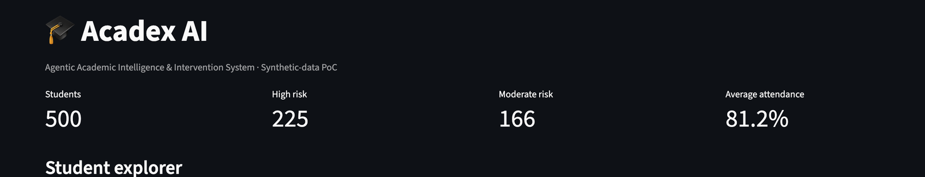
FOUNDATIONS OF AGENTIC AI
ACADEX AI
Agentic Academic Intelligence
& Intervention System
From academic signals to supportive action
SUBMITTED BY
Khushi Harkhani • 24070126091
Khushie Agrawal • 24070126092
AIML B

Slide 2

02
Problem statement
Academic monitoring can be fragmented; timely support depends on noticing patterns early.
THE CHALLENGE
WHY IT MATTERS
DOMAIN JUSTIFICATION
Attendance, assessment results and assignment completion must be reviewed together to understand a student's academic situation.
Manual review across many records can make it harder to prioritize follow-up consistently and prepare timely support.
Education is a useful agentic AI setting because multiple indicators need to be examined, checked and translated into next steps.
Acadex AI is a decision-support PoC—not an automated academic decision-maker.
ACADEX AI • FOUNDATIONS OF AGENTIC AI
2

Slide 3
03
Objectives & proposed solution
Bring student indicators into one workflow and support faculty review.
Explore synthetic student records in an interactive dashboard
PROPOSED SOLUTION
Assess risk using implemented Python rules
Student data
Coordinate specialized agents for analysis and review
Agent workflow
Validate results before presenting recommendations
Keep intervention suggestions subject to human approval
Validated action
Human-in-the-loop throughout
ACADEX AI • FOUNDATIONS OF AGENTIC AI
3

Slide 4
04
Methodology
A repeatable pipeline from synthetic records to a faculty-reviewed next step.
01
LOAD
02
SELECT
03
ORCHESTRATE
Read synthetic CSV records
Choose a student and indicators
Coordinate specialized agent tasks
04
ASSESS
05
VALIDATE
06
RECOMMEND
Python rules classify risk
Check result structure and consistency
Prepare a draft for faculty review
Data used in this demonstration is synthetic; risk labels are illustrative triage outputs.
ACADEX AI • FOUNDATIONS OF AGENTIC AI
4

Slide 5
05
Agent roles & responsibilities
Specialized roles separate planning, execution, critique, readiness checks and follow-up preparation.
Planner
Research
Executor
Organizes the workflow
and analysis steps
Examines academic
indicators
Applies Python rules
and structures results
Critic
Software Development
Business Automation
Reviews consistency
of results
Checks schema, required
fields and record IDs
Prepares intervention
drafts for faculty
Gemini supports language-based tasks; deterministic risk calculation is performed by Python.
ACADEX AI • FOUNDATIONS OF AGENTIC AI
5

Slide 6
06
End-to-end pipeline
The dashboard triggers a backend workflow; validation gates the result before it is shown.
Dashboard
FastAPI
Agents
Python
Validation
Faculty
Select student
and run workflow
Receive request
and orchestrate
Plan • Research
Critique • Prepare
Calculate risk
and structure output
Check output
before returning
Review suggested
next action
Fallback behavior is available if the language model is unavailable; intervention remains a draft.
ACADEX AI • FOUNDATIONS OF AGENTIC AI
6

Slide 7
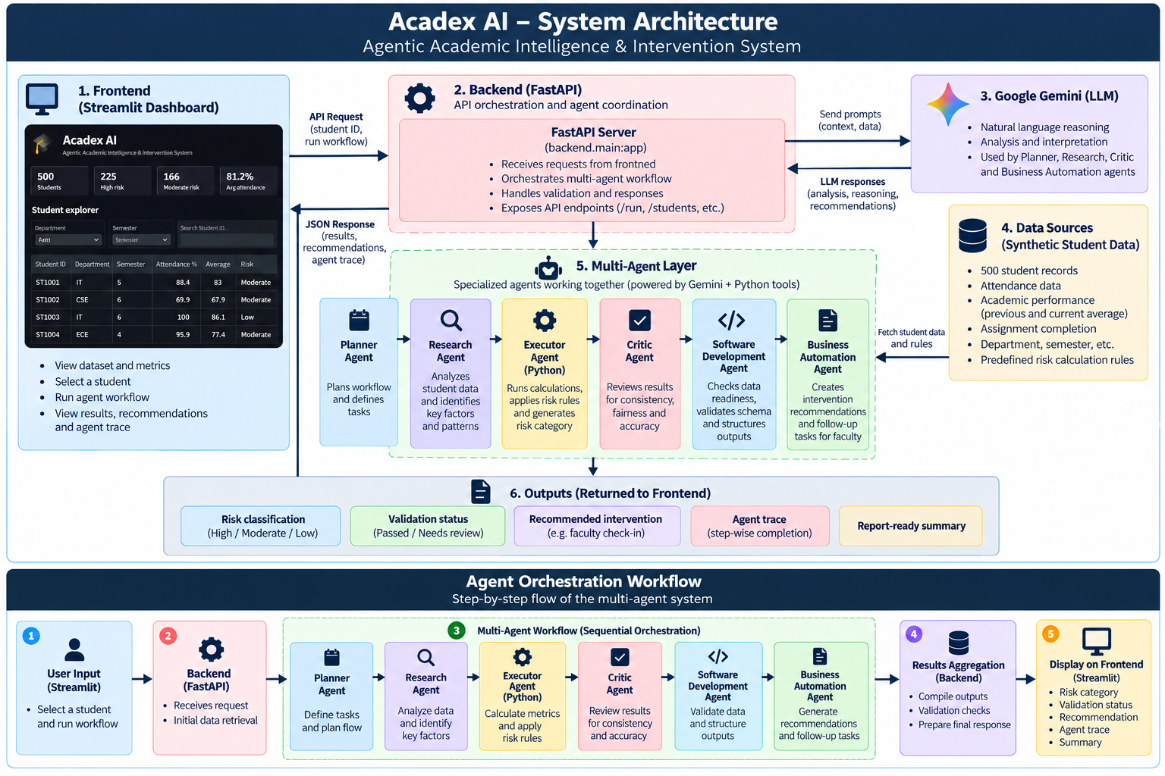
07
System Architecture
Implementation-aligned view of the interface, backend, agent workflow, tools and human oversight.
7

Slide 8
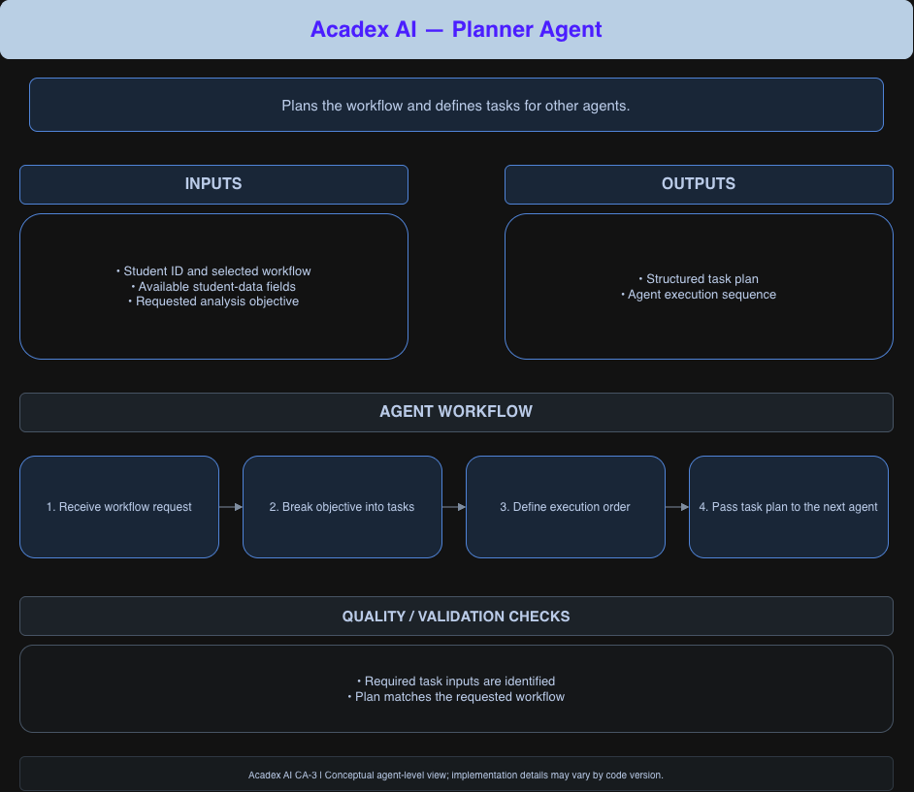
Agent Orchestration
  Planner Agent

Slide 9
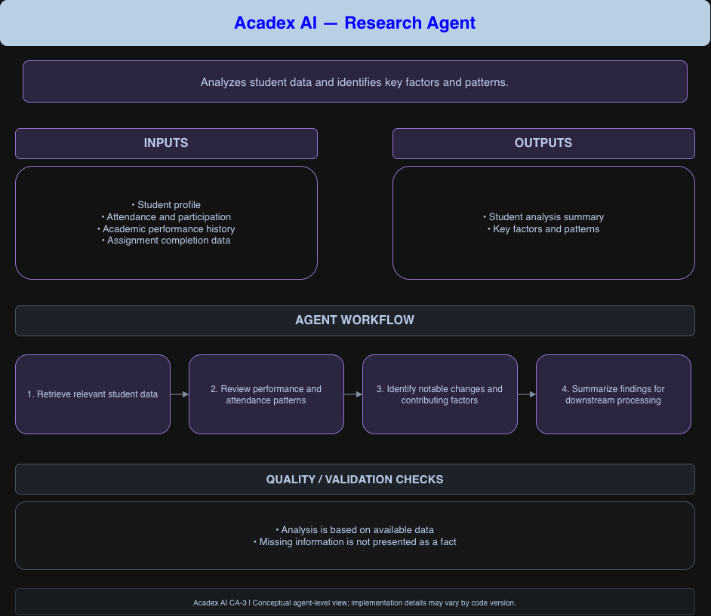
Agent Orchestration
  Research Agent

Slide 10
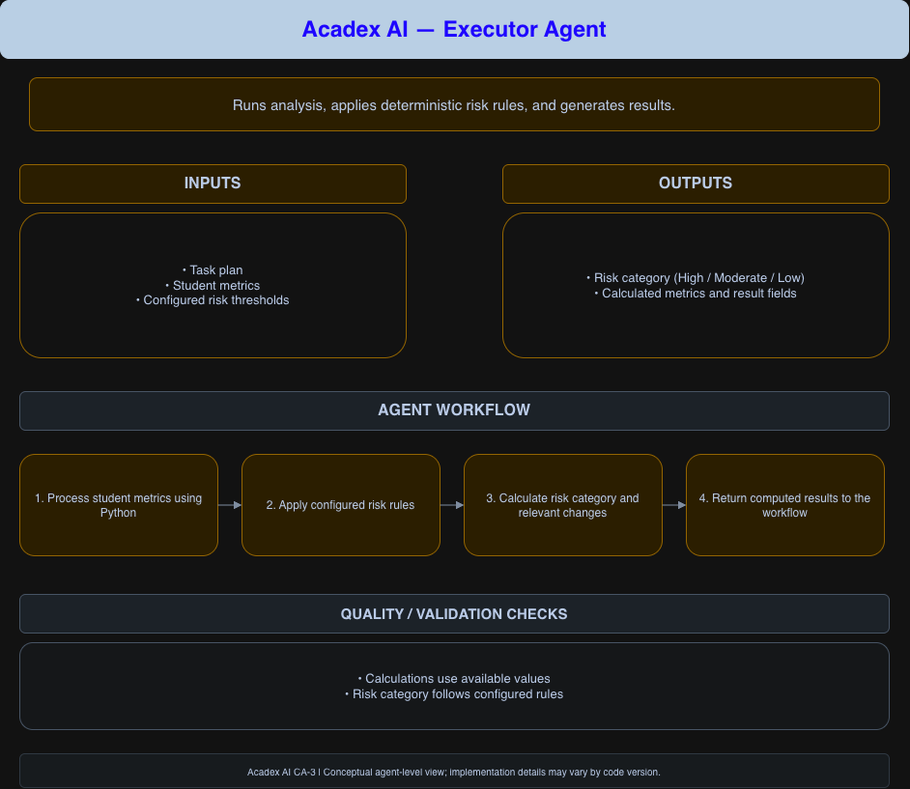
Agent Orchestration
  Executor Agent

Slide 11
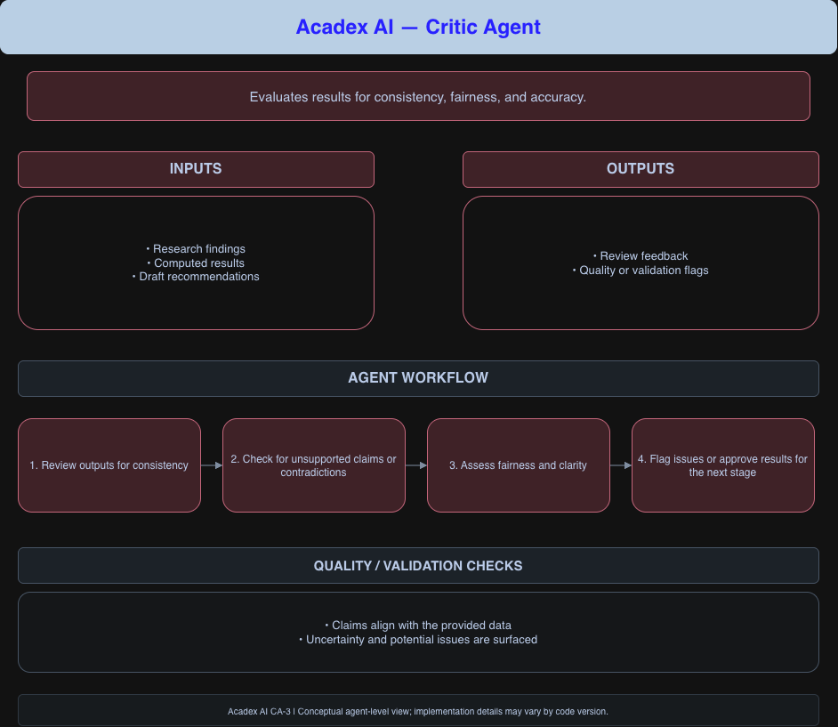
Agent Orchestration
  Critic Agent

Slide 12
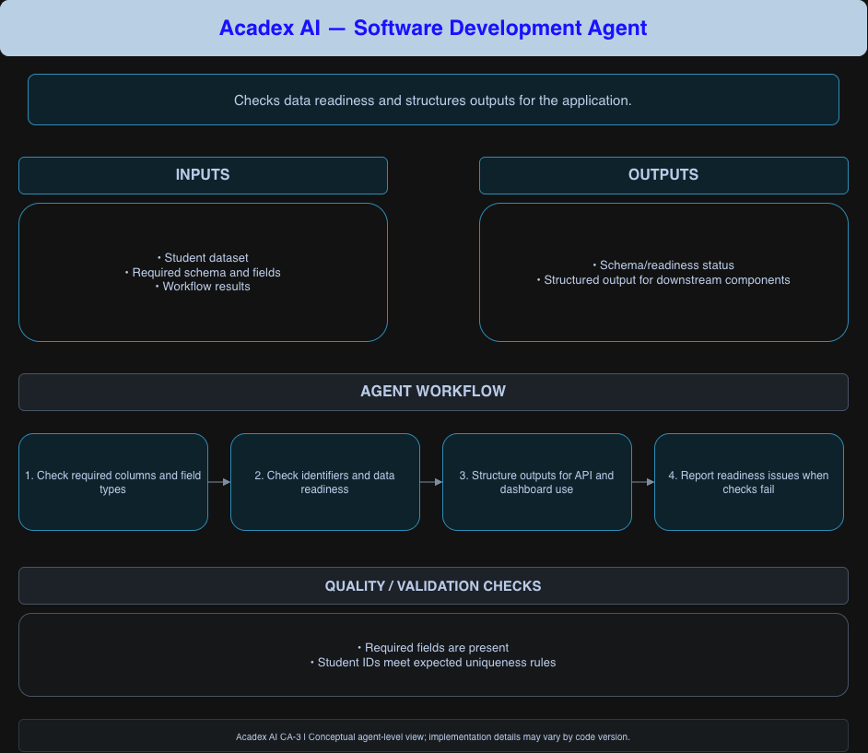
Agent Orchestration
  Software Development Agent

Slide 13
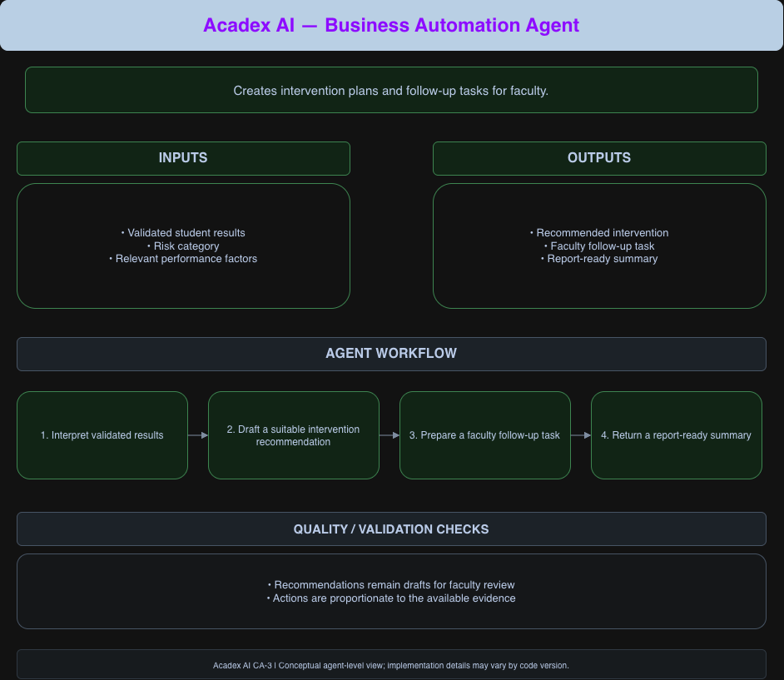
Agent Orchestration
  Business Automation Agent

Slide 14
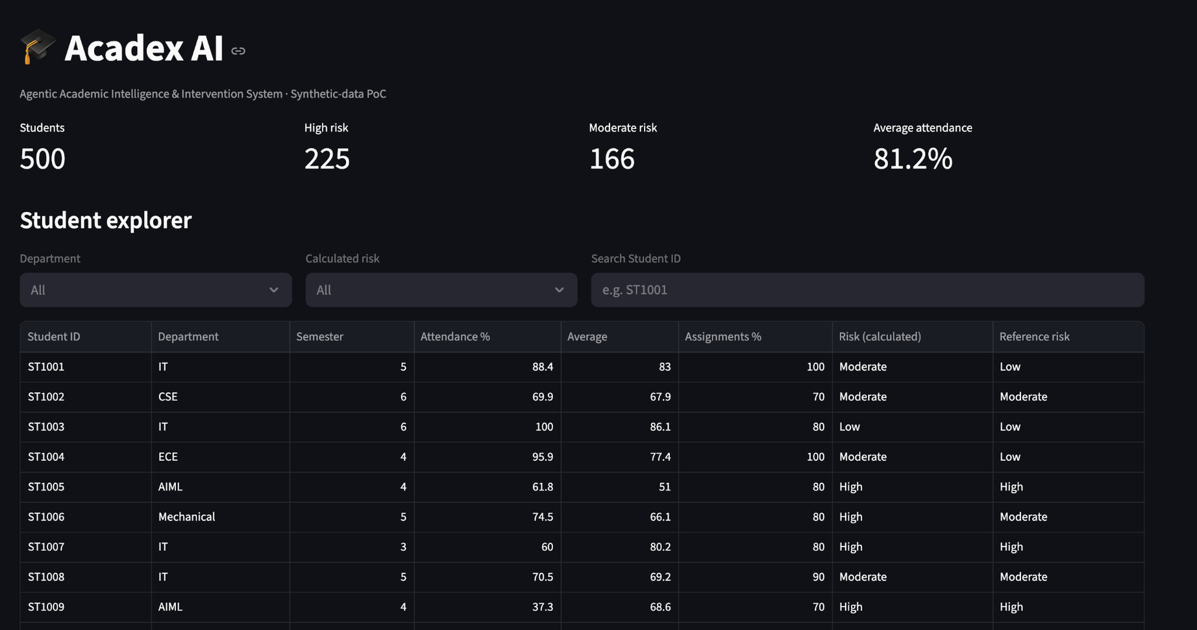
08
Dashboard: academic overview
The interface summarizes the synthetic dataset and supports filtering and student-level exploration.
ACADEX AI • FOUNDATIONS OF AGENTIC AI
8

Slide 15
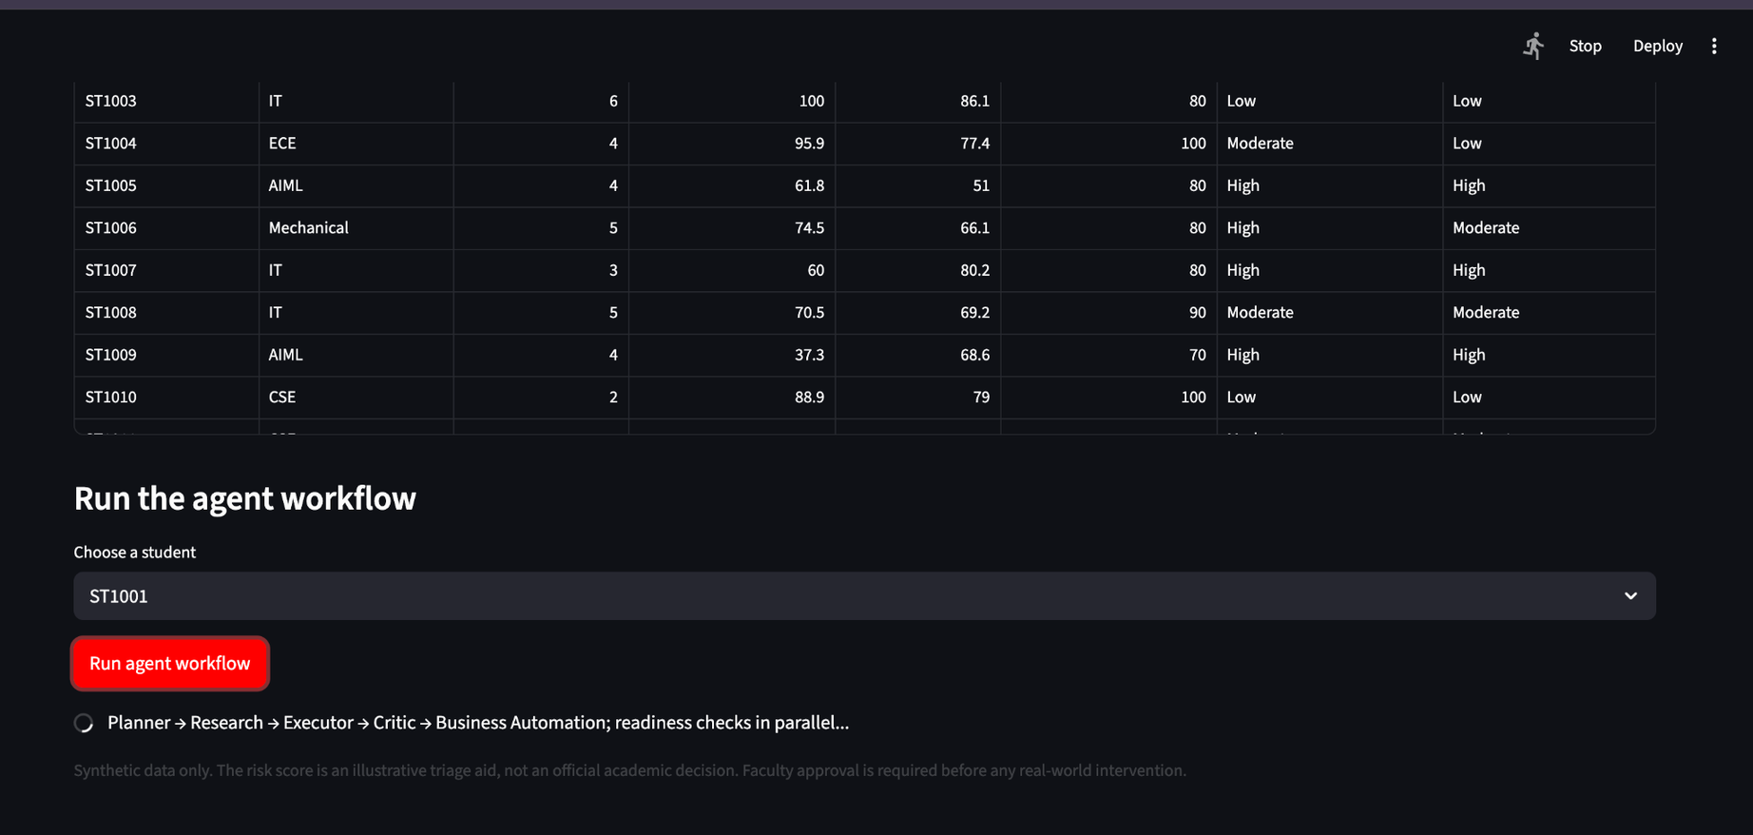
09
Agent workflow: completed and validated
Example output for synthetic student ST1001.
RISK
Moderate
VALIDATION
Passed
RECOMMENDATION
Faculty check-in this week; agree on one attendance or assignment improvement goal.
ACADEX AI • FOUNDATIONS OF AGENTIC AI
9

Slide 16
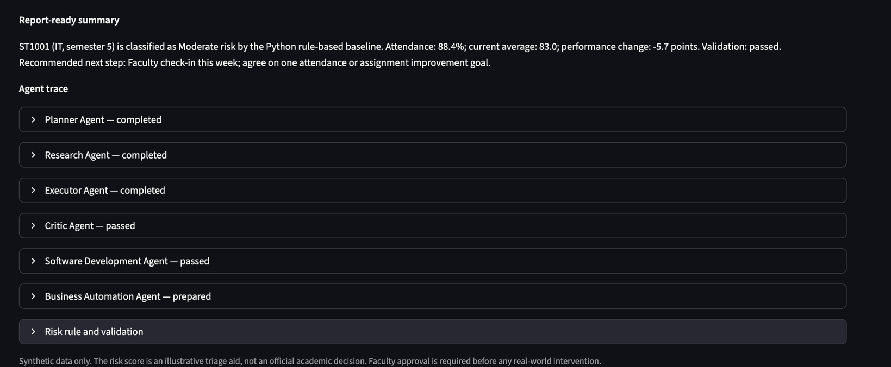
10
Agent trace & report-ready summary
The PoC exposes agent completion states and a concise explanation of the generated assessment.
EXAMPLE STUDENT
ST1001 • IT • Semester 5
SIGNAL IDENTIFIED
Performance down 5.7 points
HUMAN OVERSIGHT
Recommendation is advisory; faculty review is required.
ACADEX AI • FOUNDATIONS OF AGENTIC AI
10

Slide 17
11
Results, limitations & next steps
The prototype demonstrates a functioning workflow; real-world use would require further evaluation.
WHAT WORKS
CURRENT LIMITATIONS
FUTURE SCOPE
• 500 synthetic records
• Dashboard filtering and search
• Multi-agent workflow
• Successful validation
• Synthetic data only
• Rule-based risk classification
• No real-world accuracy evaluation
• LLM output needs oversight
• Evaluate on approved anonymized data
• Explain risk factors
• Add audit and access controls
• Track intervention outcomes
Acadex AI turns academic signals into structured, reviewable support—not automated decisions.
ACADEX AI • FOUNDATIONS OF AGENTIC AI
11

Slide 18
THANK YOU!

